Slide 1

CS302 Design and Analysis of Algorithms
Muhammad sohail afzal

Slide 2
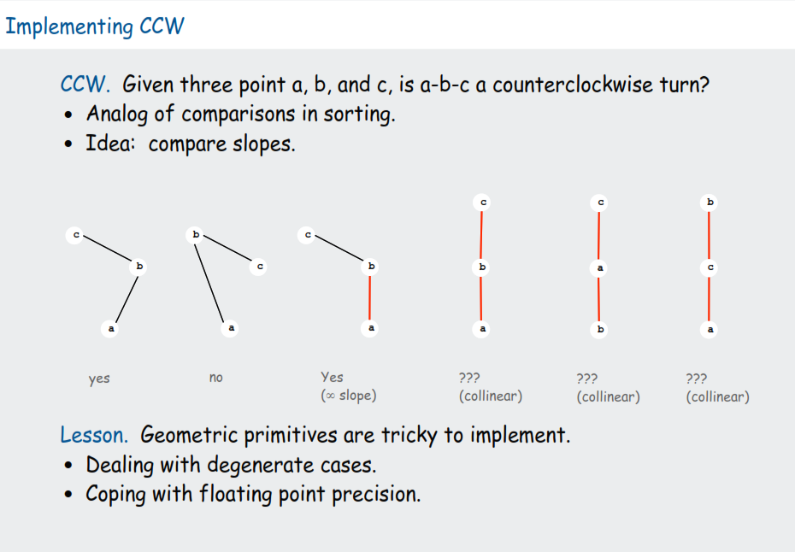
Geometric algorithms: Intro

Slide 3
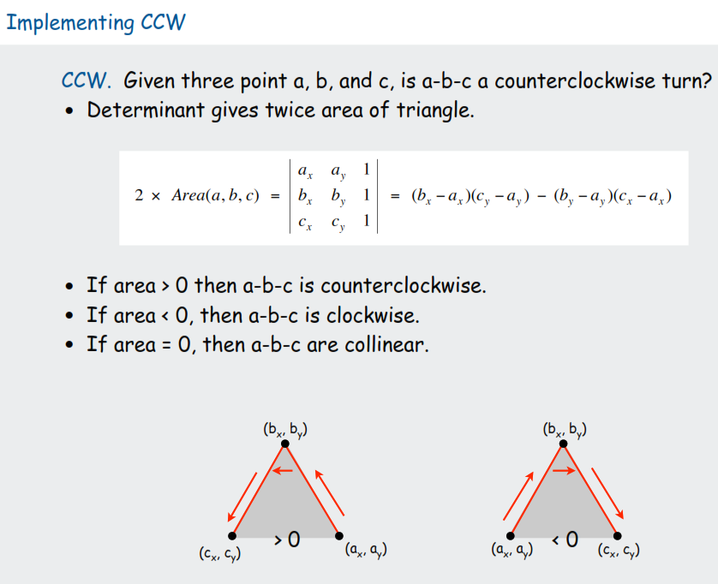
Geometric algorithms: Intro

Slide 4
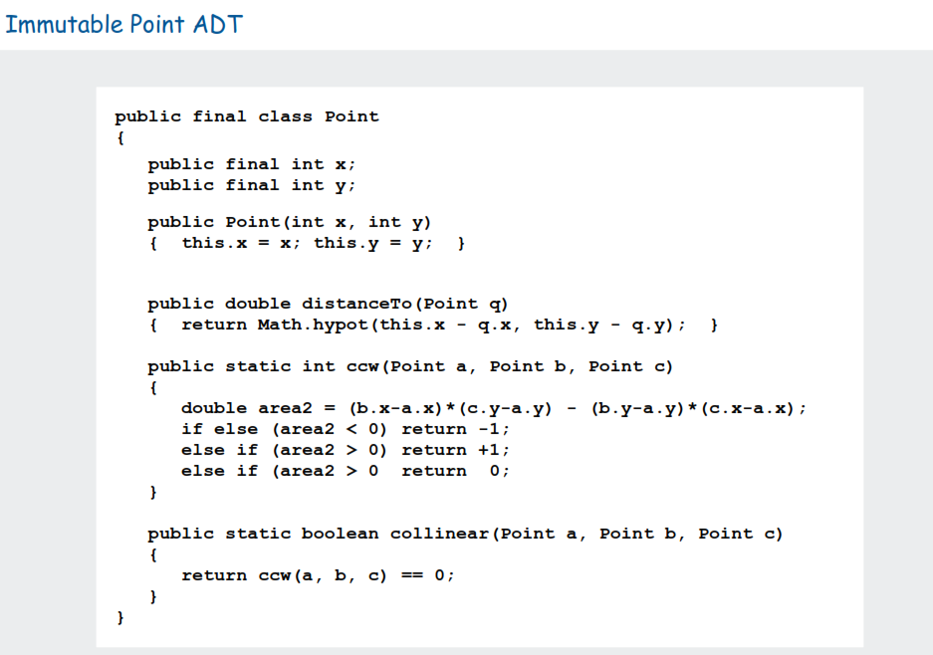
Geometric algorithms: Intro

Slide 5
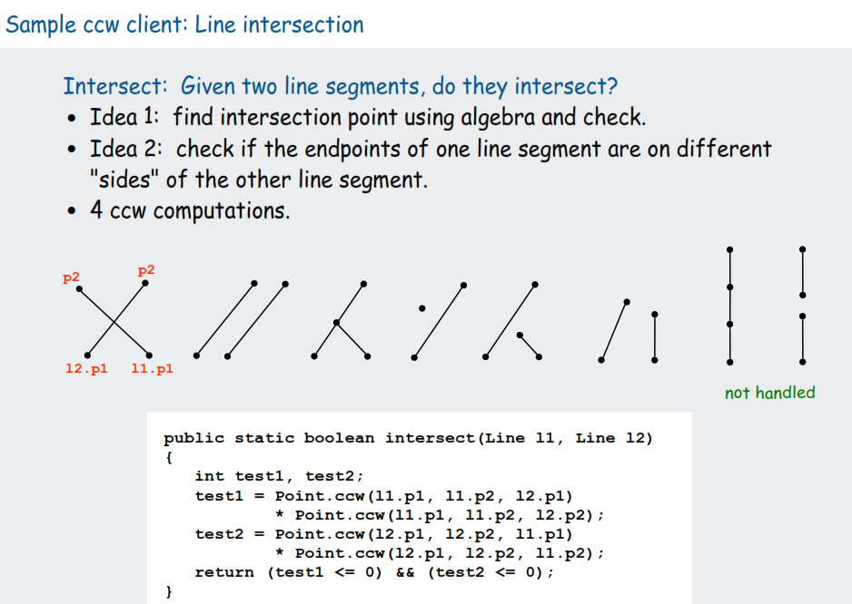
Geometric algorithms: Intro

Slide 6
Geometric algorithms : Convex Hull
We have already studied graham scan algorithm for making convex hull.
Lets study Brute force algorithm and Jarvis march algorithm for making convex hull.

Slide 7
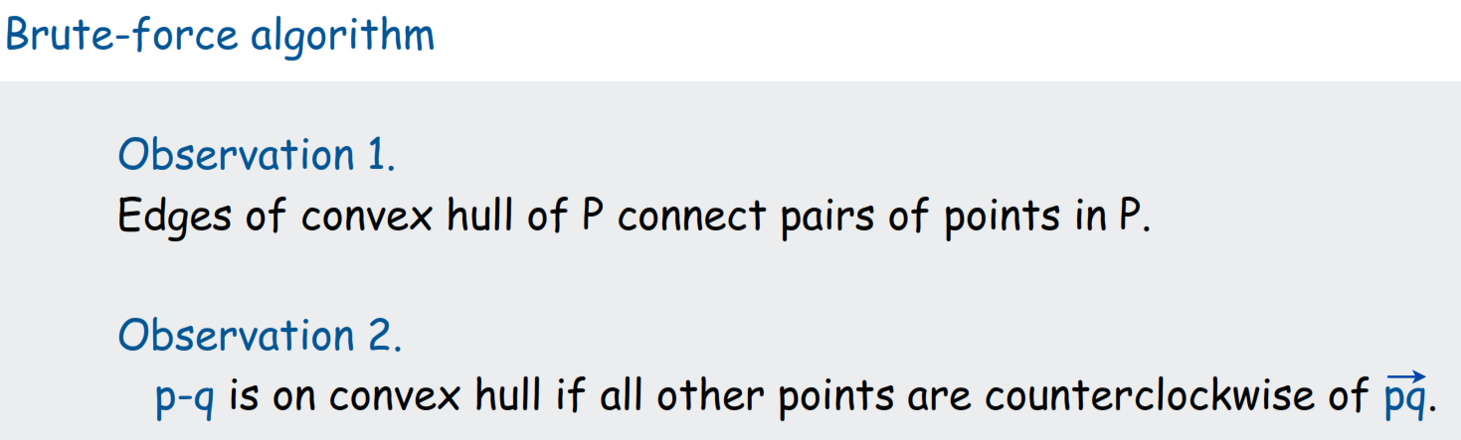
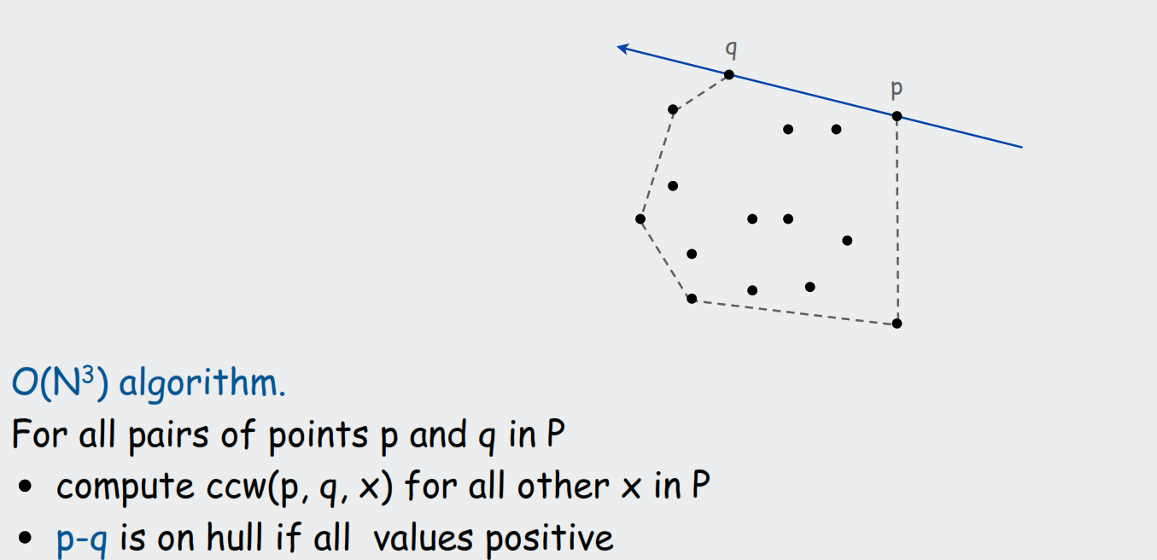
Geometric algorithms : Brute force algorithm for convex hull

Slide 8
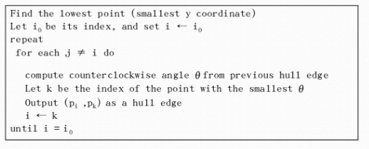
Geometric algorithms : Jarvis March algorithm for convex hull
Jarvis March algorithm for Convex Hull:

Slide 9
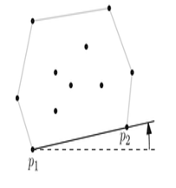
Geometric algorithms : Jarvis March algorithm for convex hull

Slide 10
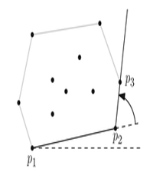
Geometric algorithms : Jarvis March algorithm for convex hull

Slide 11
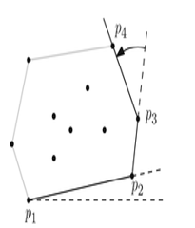
Geometric algorithms : Jarvis March algorithm for convex hull

Slide 12
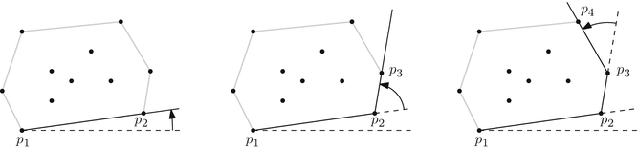
Geometric algorithms : Jarvis March algorithm for convex hull
Jarvis March algorithm for Convex Hull:

Slide 13
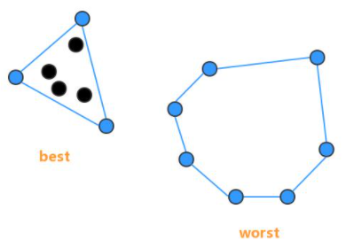
Geometric algorithms : Jarvis March algorithm for convex hull
Time complexity of Jarvis march is O(nh).
where “n” is the total number of vertices(points) and “h” is the number of vertices(points) that make up the boundry of convex hull.
Worst case time = O(n^2) which occurs when all points lie at the boundry of convex hull

Slide 14
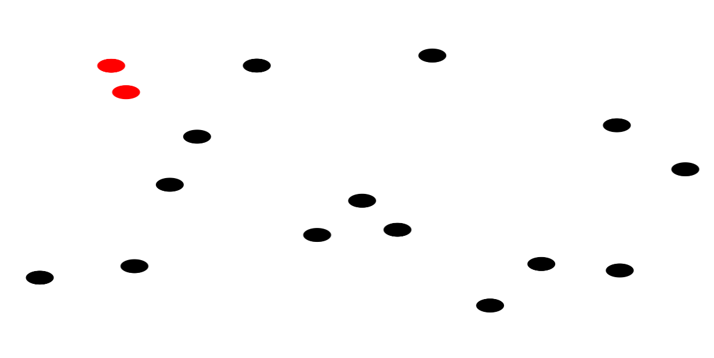
Geometric algorithms : Closest pair problem
Closest Pair Problem :
Given a set of points, we need to find a pair of points where distance between those two points is minimum than distance between any other pair of points.

Slide 15
Geometric algorithms : Closest Pair Problem
Applications :
Collision detection
Hierarchical Clustering
Straight skeleton and roof design
and many more

Slide 16
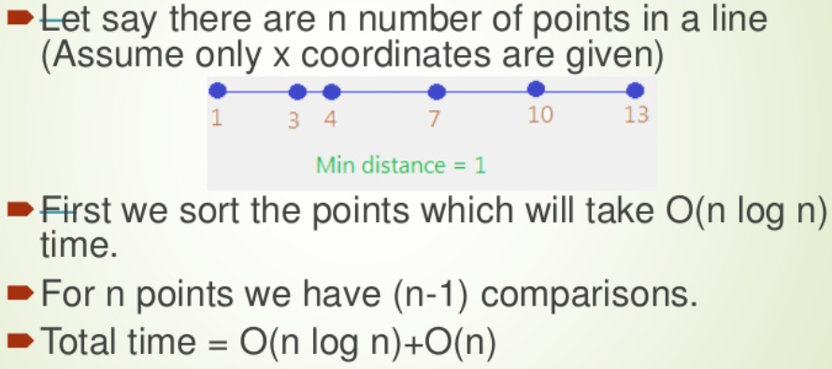
Geometric algorithms : Closest Pair Problem
1-dimension : It is easy to find closest pair in O(nlogn) time if points are in 1-dimension.

Slide 17
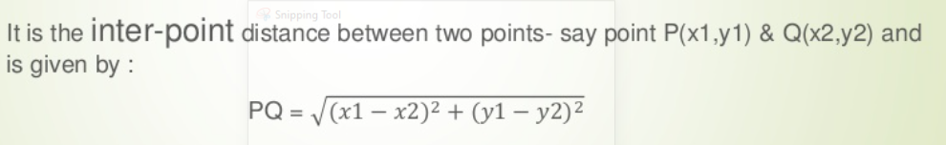
Geometric algorithms : Closest Pair Problem
If points are in 2-dimension then we can use Euclidian Distance to find distance between two points
Euclidian distance :

Slide 18
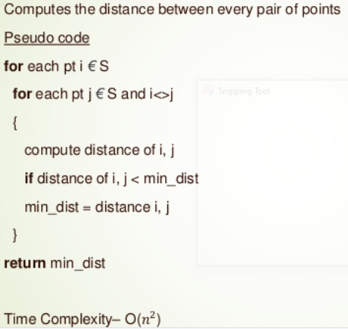
Geometric algorithms : Closest Pair Problem
Brute Force Approach : We can use nested for loops to calculate distance (through Euclidian distance formula) between every pair of points and can return minimum at the end. This will take O(n^2) time

Slide 19
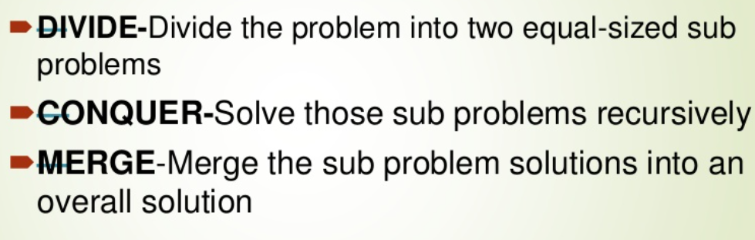
Geometric algorithms : Closest Pair Problem
Divide and Conquer Strategy : It finds closest pair in O(nlogn) time if points are in two dimension.
We apply divide and conquer strategy by first finding the median so that points can be partitioned across median value in two halves. Median sorts the points according to their x coordinate and then partition them equally. So algorithm works as follows :

Slide 20
Geometric algorithms : Closest Pair Problem
First we need to partition points based on median of x-coordinate values of all points.
For example, if we have points (2,3),(5,4),(1,6),(3,2) then to find median based on x-coordinate values , first sort values :
X-coordinate values = 2,5,1,3
After sorting = 1,2,3,5
If total number of values are odd then median is middle value. If even then median is the average of two middle values. Here the total values are 4 which is even so :
Median = (2+3)/2 = 2.5 (So we need to draw vertical partition line at x=3.5 that will divide total points in two halves.

Slide 21
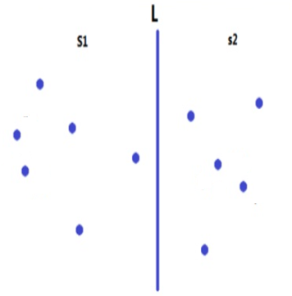
Geometric algorithms : Closest Pair Problem
Partition Line

Slide 22
Geometric algorithms : Closest Pair Problem
Then we need to find :
1) Closest pair in left half
2) Closest pair in right half
3) Closest pair across partition line
Then we can take minimum of three which will give us closest pair
of points

Slide 23
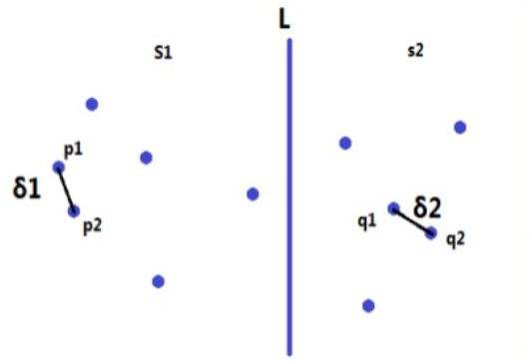
Geometric algorithms : Closest Pair Problem
First we can find closest pair in left half (delta_1) and right half (delta_2).
We will take minimum of two distances (delta_1 and delta_2)
Suppose this minimum distance is delta.
Now we need to find pair of points (if exists) such that one point lie in left
and one point in right half and distance between them is less than delta.
How can we do that !

Slide 24
Geometric algorithms : Closest Pair Problem
Finding closest pair across partition line:
By taking points one by one from left half and then checking their distance with all points in other half will take O(n^2) time as its brute force approach. This does not solve our problem.
Can we find closest pair across partition line in O(n) time ?
Suppose finding closest pair in left half takes T(n/2) time
Suppose finding closest pair in right half takes T(n/2) time
If finding closest pair across partition line takes O(n) time then
Total time = 2T(n/2) +n = O(nlogn)

Slide 25
Geometric algorithms : Closest Pair Problem
Finding closest pair across partition line:
By taking points one by one from left half and then checking their distance with all points in other half will take O(n^2) time as its brute force approach. This does not solve our problem.
Can we find closest pair across partition line in O(n) time ?
If we can then :
Suppose finding closest pair in left half takes T(n/2) time
Suppose finding closest pair in right half takes T(n/2) time
If finding closest pair across partition line takes O(n) time then
Total time = 2T(n/2) +n = O(nlogn)

Slide 26
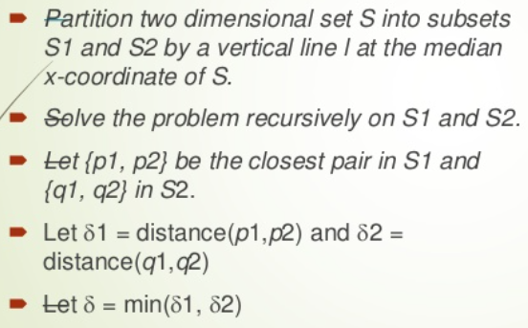
Geometric algorithms : Closest Pair Problem
We have done this till now :

Slide 27
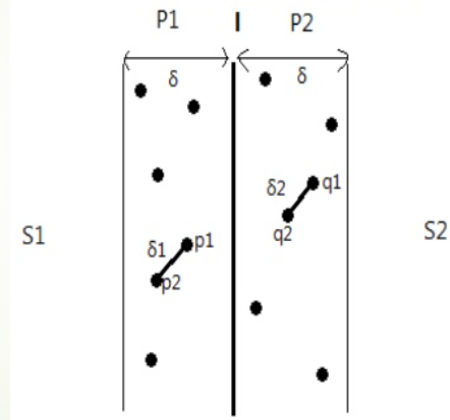
Geometric algorithms : Closest Pair Problem
Approach of finding closest pair across partition line in O(n) time :
We have already got one closest pair from left and right half (delta).
Now we are only interested in closest pairs across partition line
having distance less than delta.
So instead of considering all points, take only those points from
Left and right half that are at a distance of delta from partition line.

Slide 28
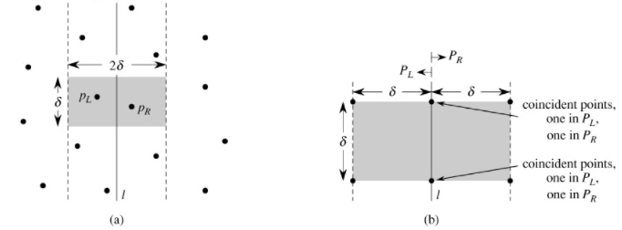
Geometric algorithms : Closest Pair Problem
If we are taking any point (across partition line) to start comparing then there could be at most 4 points in one half that could be at most delta distance apart from that point. 4 points for other half so total 8 points. We do not need to compare it with remaining points as those will be more than delta distance apart from that point.
consider PL and PR in this figure as P1 and P2 respectively (left and right half)

Slide 29
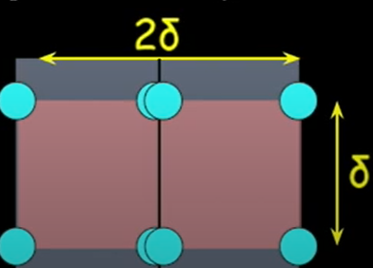
Geometric algorithms : Closest Pair Problem
To get a more clear view of those 8 points that we need to compare with :
If we compare every point with its next 7 points only then total operations = 7n = O(n)

Slide 30
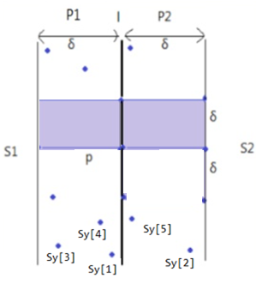
Geometric algorithms : Closest Pair Problem
Let “Sy” is array that contains all the points of P1 and P2
in ascending order of y coordinate. Like in diagram, these points
will be labeled as ( Sy[1], Sy[2], Sy[3],.…,Sy[n] )
Then we need to compare first point of Sy known as “Sy[1]” with
next 7 points “Sy[2], Sy[3], Sy[4], Sy[5], Sy[6],Sy[7],Sy(8) “ and find distance
with each seven points to check if it is less than . If it is then update .
We do not need to check distance with 8th point and onwards
because it will be greater than .
After that, we will take second point of Sy known as “Sy[2]”
and will compare it with next seven points“Sy[3], Sy[4], Sy[5],….,Sy[9]” and this will go on till we
iterate each point of Sy. So these will be total 7n operations = O(n)

Slide 31
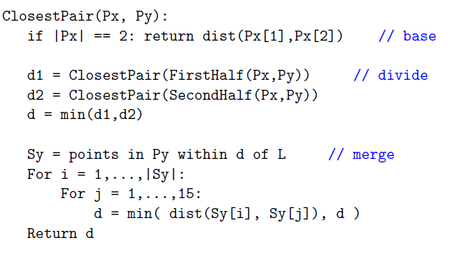
Geometric algorithms : Closest Pair Problem

Slide 32
Geometric algorithms : Closest Pair Problem
Time Complexity :
Time to find closest pair in left half = T(n/2)
Time to find closest pair in right half = T(n/2)
Time to find closest pair across partition = 6n = O(n)
Total time = 2T(n/2) + n = O(nlogn)

Slide 33
Geometric algorithms : Closest Pair Problem
Video Link :
https://www.youtube.com/watch?v=6u_hWxbOc7E

